Slide 1
INI Generalized Video Game AI
26 Feb 2015

Slide 2
GVGAI Competition
Code an agent in Java
Must respond in realtime (40 ms)
Can query the environment, score, and live/dead status
Can make use of a forward model that describes the game if a specific action is taken
Three sets of 10 games for training
Secret validation set (10 games) used for public rankings
Secret test set (10 games) for final competition results
Emphasis on puzzle games this year

Slide 3
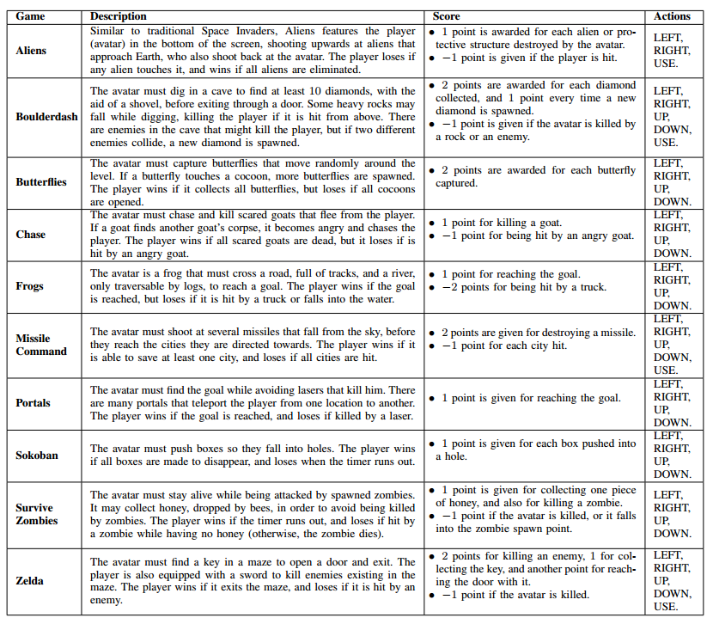
Games From the 2013 Competition

Slide 4
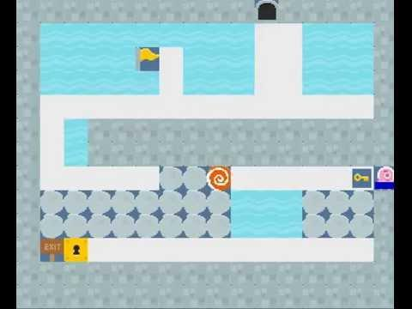
RealPortals

Slide 5
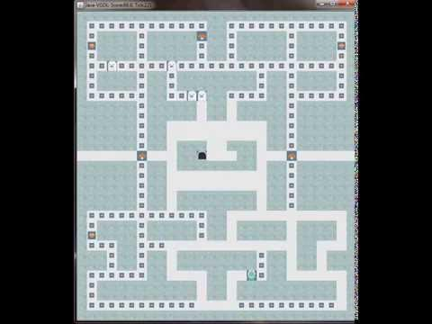
Pacman

Slide 6
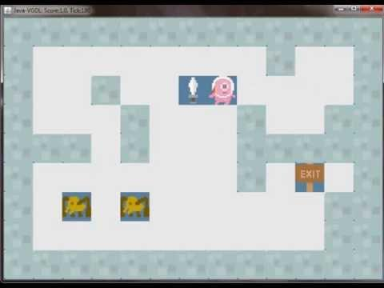
Zelda

Slide 7
VGDL - Sokoban
BasicGame
SpriteSet
hole > Immovable color=DARKBLUE img=hole
avatar > MovingAvatar #cooldown=4
box > Passive img=box
LevelMapping
0 > hole
1 > box
InteractionSet
avatar wall > stepBack
box avatar > bounceForward
box wall > undoAll
box box > undoAll
box hole > killSprite scoreChange=1
TerminationSet
SpriteCounter stype=box limit=0 win=True

Slide 8
Sample Controller
package random; //The package name is the same as the username in the web.
public class Agent extends AbstractPlayer { protected Random randomGenerator; //Constructor. It must return in 1 second maximum. public Agent(StateObservation so, ElapsedCpuTimer elapsedTimer) { randomGenerator = new Random(); } //Act function. Called every game step, it must return an action in 40 ms maximum. public Types.ACTIONS act(StateObservation stateObs, ElapsedCpuTimer elapsedTimer) { //Get the available actions in this game. ArrayList<Types.ACTIONS> actions = stateObs.getAvailableActions(); //Determine an index randomly and get the action to return. int index = randomGenerator.nextInt(actions.size()); Types.ACTIONS action = actions.get(index); //Return the action. return action; } }

Slide 9
Demo

Slide 10
How this is going to work
Meet every 2 weeks, two parts:
Discuss competition progress
Learn a new topic
You must write code (but can learn!)
We will have a listserv
Sign up for a focus team, for example:
TeamHuman - mimic human players, learn strategies humans employ and typical game archetypes
TeamLearning - use learning as much as possible to design an agent that learns by itself
TeamPlanning - learn and prototype really effective planning algorithms

Slide 11
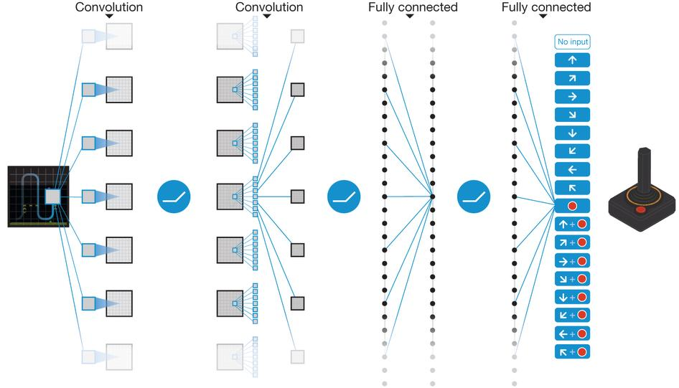
Academically...
V Mnih et al. Nature 518, 529-533 (2015) doi:10.1038/nature14236

Slide 12
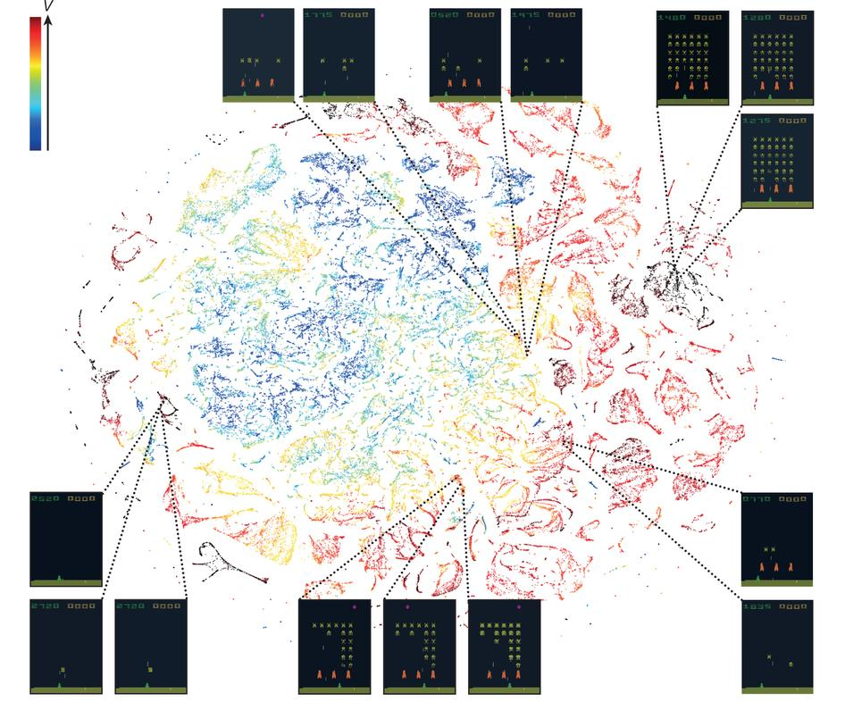
Academically...
V Mnih et al. Nature 518, 529-533 (2015) doi:10.1038/nature14236

Slide 13
Looking ahead
3/12: Introduction to Reinforcement Learning
3/26: Overview of Traditional Strategies for Planning (Monte-Carlo Tree Search, Evolutionary Algorithms, POMDP)
4/9: DeepMind GVGAI
4/23: To be determined!

Slide 14
Tasks
Codebase Manager
Send out email about install and setup
Manage commits and contributions
Main Optimizer
Take the best submissions, look for small tweaks, do official submissions
Speakers:
Intro to Reinforcement Learning
Intro to Planning Algorithms

Slide 15
Next Week
Introduction to Reinforcement Learning
Join the email list
Install and setup GVGAI on your computer

